Slide 1
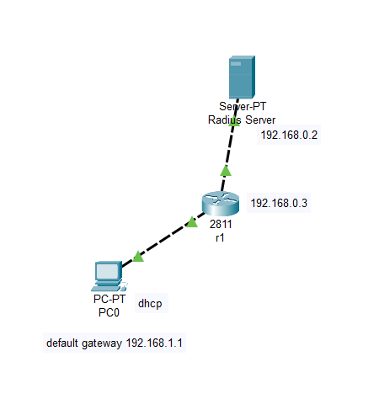
<Radius Implementation>
Project Overview
Problem: To link the Router and the Server up with a client to ensure that it has authentication and authorization to the Server
Requirements:
1. Authentication of admin and user using RADIUS authentication methods.
2. Authorization of admin and user using RADIUS service.
3. Students demonstrate the implementation of the authentication server on their laptop using VM.
Solution:
To create an authentication service with Radius server for a small corporate company. Different staff of different departments to gain authorization and authentication through different types of Networking Authentication Protocols. (EAP,PAP,CHAP,MD5 etc.)
Technologies: RADIUS. Packet Tracer, Vmware
Team Members
Timorthy Tng. Liang Kok, Hong Jun
Mr Bernard Leong (supervisor)
Notes:
NOTES
Refer to write ups in ‘Past Projects for Reference’ Booklet for Project overview write ups - http://yoda.soi.rp.edu.sg/wiki/index.php/FYP_Wiki
ENGLISH - British E.g. organisation VS organization
Font: RP approved font - Arial family only.
Header: Arial Bold
Copy text: Arial regular or Arial Bold. Use Emphasis of our SOI orange in moderation.
Picture frame – Give a 4.5 or 6pt orange outline.

